Slide 2
The Call of Cthulhu: Summoning X++ Performance and Tuning Mastery

Slide 3

The Call of Cthulhu: Summoning X++ Performance and Tuning Mastery

Slide 4


Nathan Clouse
Technical Architect
Microsoft MVP 5x
Armanino AtomicAX.com Dynamics.fo

Slide 5
Performance
Why are things slow?
Can I speed things up?
How can I do that?

Slide 6
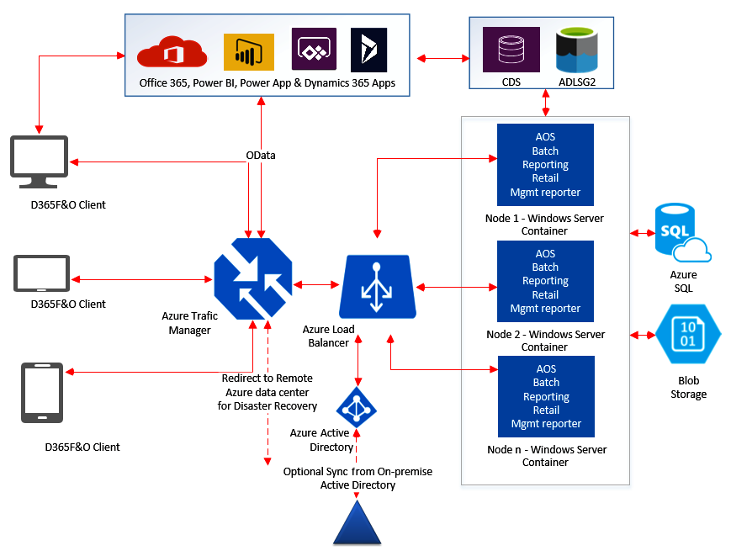
Architecture

Slide 8

Common Problems
Poor Indexing
Poor Loop architectures
Not using Batch processing
Not using indexes
Not creating indexes

Slide 9

Identifying Common Problems
Symptoms of performance degradation
“Its slow”
Where? When? In what legal entity? For which process?
Collect a trace for the process plus a recording to repro
Differentiating between code-level and database-level issues
Is opening a form slow?
Or is clicking on a specific button taking a long time?

Slide 10
Code – Bad Pattern - Insert
for(int i = 0; i <= this.parmRecordCount(); i++)
{
ttsbegin;
SalesPool.SalesPoolId = int2Str(i);
SalesPool.Name = int2Str(i);
SalesPool.insert();
ttscommit;
}

Slide 11
Code – Good Pattern - Insert
ttsbegin;
for(int i = 0; i <= this.parmRecordCount(); i++)
{
SalesPool.SalesPoolId = int2Str(i);
SalesPool.Name = int2Str(i);
SalesPool.insert();
}
ttscommit;

Slide 12
Code – Better Pattern - Insert
RecordInsertList SalesPoolList;
SalesPoolList = new RecordInsertList(tableNum(SalesPool));
SalesPool SalesPool;
ttsbegin;
for(int i = 0; i <= this.parmRecordCount(); i++)
{
SalesPool.SalesPoolId = int2Str(i);
SalesPool.Name = int2Str(i);
SalesPoolList.add(SalesPool);
}
SalesPoolList.insertDatabase();
ttscommit;

Slide 13
Code – Best Pattern - Insert
SalesPool SalesPool;
var insertObject = new SysDaInsertObject(SalesPool);
insertObject.fields()
.add(fieldStr(SalesPool, SalesPoolId))
.add(fieldStr(SalesPool, Name));
tmpSalesPool source;
var qe = new SysDaQueryObject(source);
var s1 = qe.projection()
.Add(fieldStr(tmpSalesPool, SalesPoolId))
.Add(fieldStr(tmpSalesPool, Name));
insertObject.query(qe);
var insertStmt = new SysDaInsertStatement();
ttsbegin;
insertStmt.executeQuery(insertObject);
ttscommit;

Slide 14
SalesPool SalesPool;
var insertObject = new SysDaInsertObject(SalesPool);
insertObject.fields()
.add(fieldStr(SalesPool, SalesPoolId))
.add(fieldStr(SalesPool, Name));

Slide 15
tmpSalesPool source;
var qe = new SysDaQueryObject(source);
var s1 = qe.projection()
.Add(fieldStr(tmpSalesPool, SalesPoolId))
.Add(fieldStr(tmpSalesPool, Name));

Slide 16
insertObject.query(qe);
var insertStmt = new SysDaInsertStatement();
ttsbegin;
insertStmt.executeQuery(insertObject);
ttscommit;

Slide 17
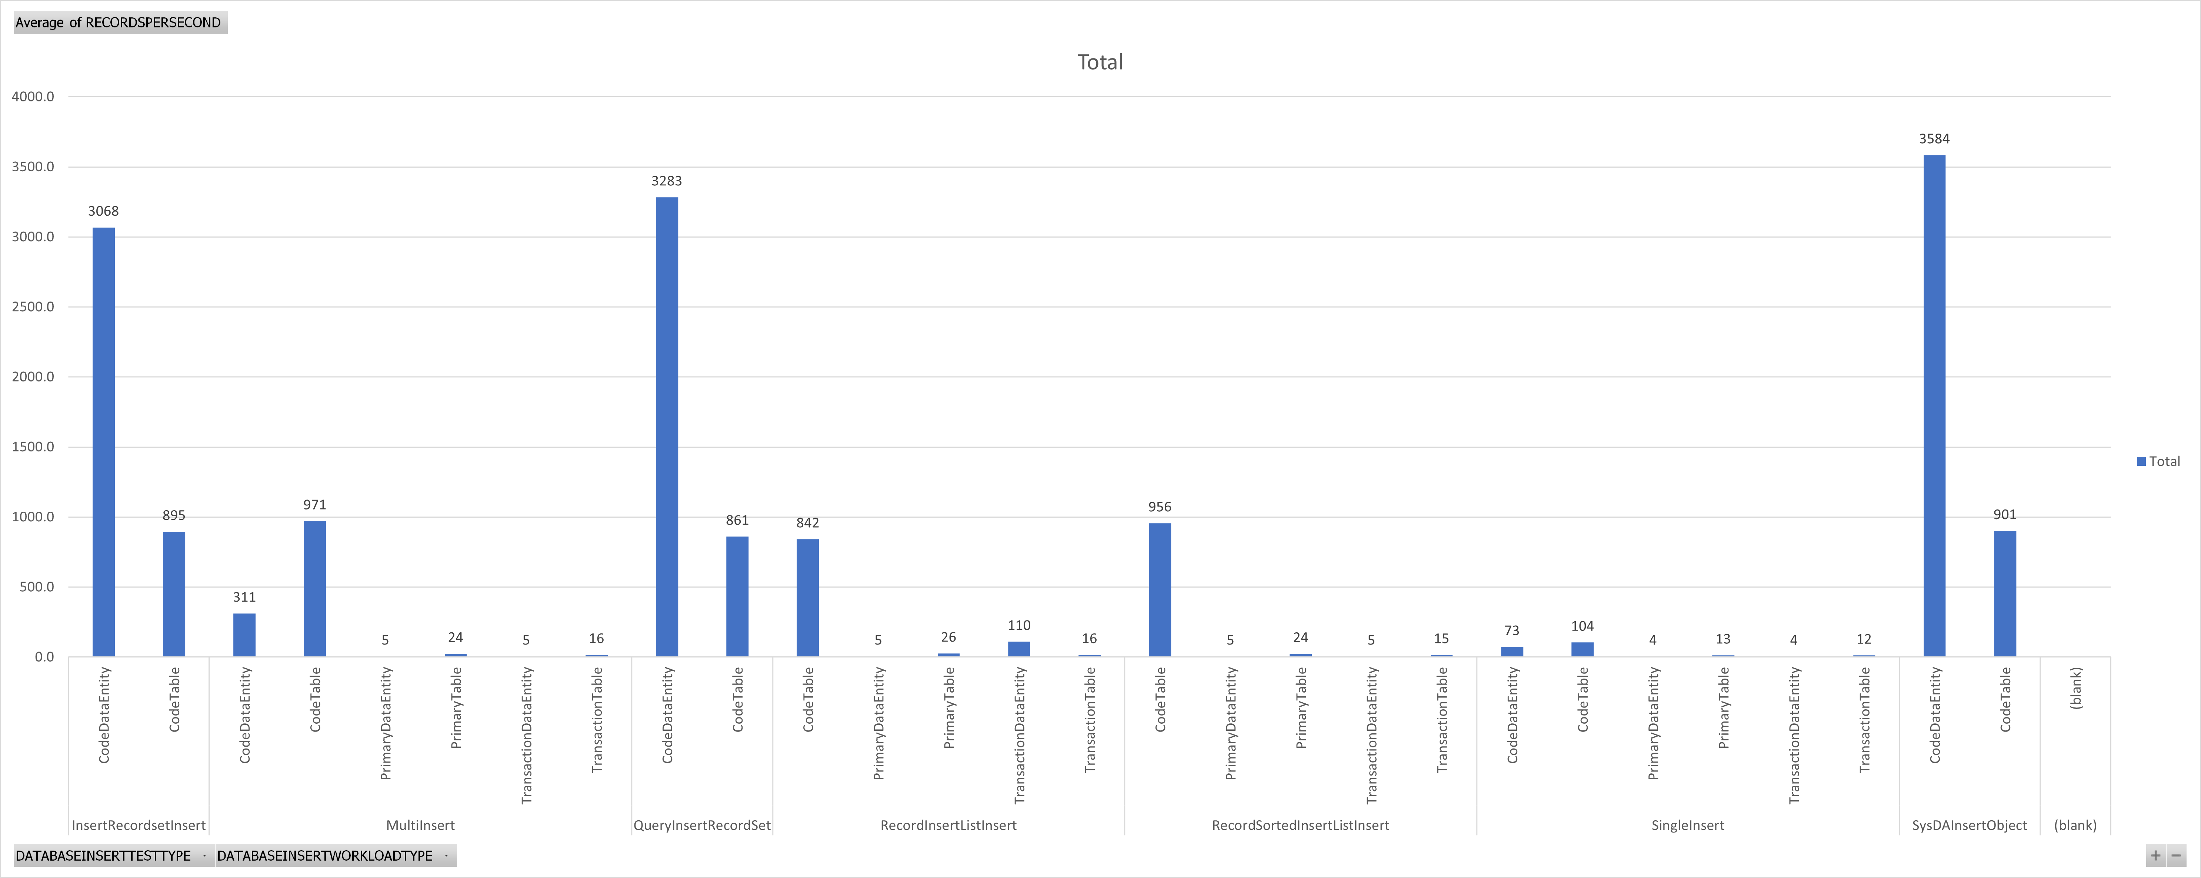
Select Into
Select Into
Best
Better
Good
Worst

Slide 18
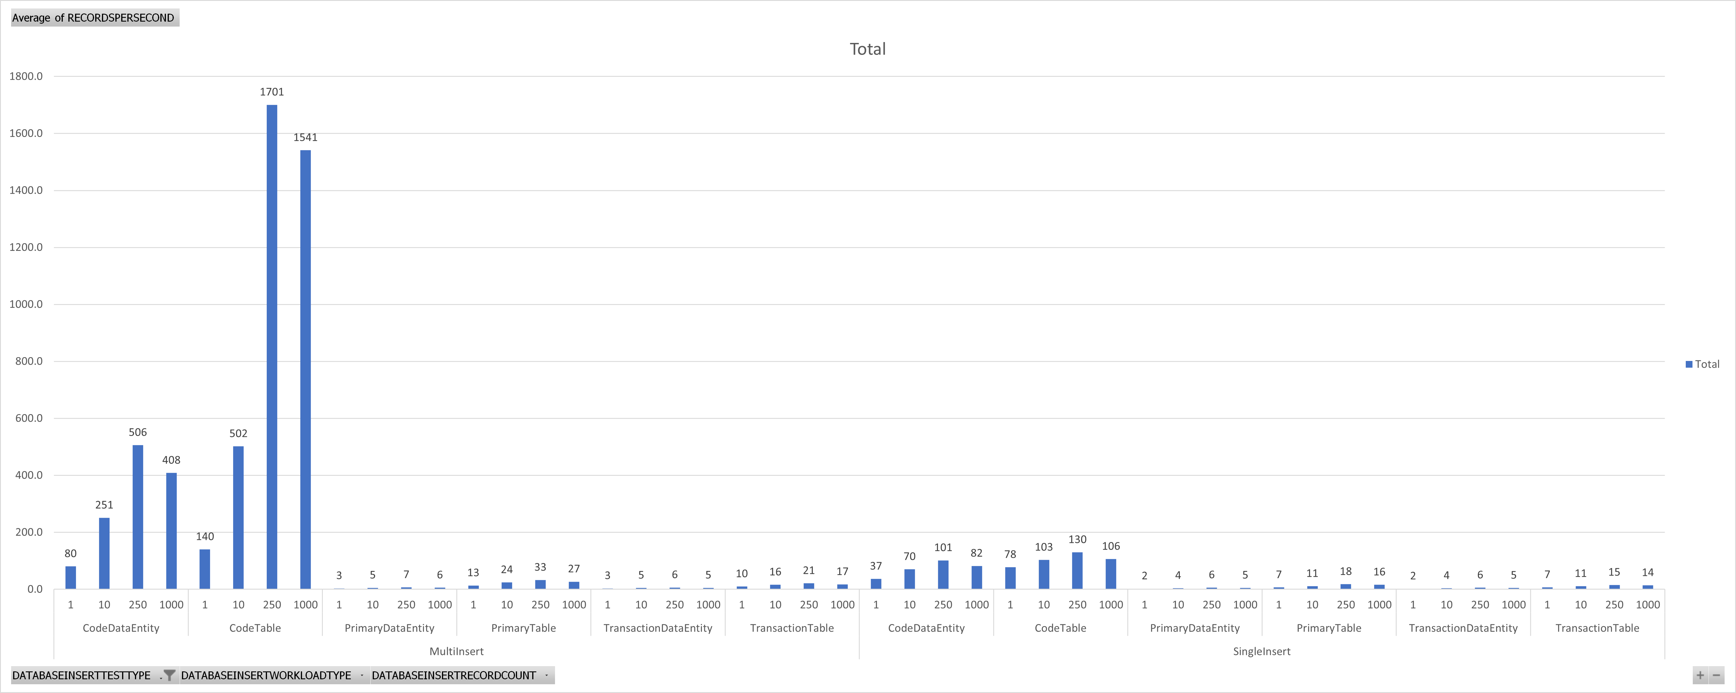
Good
Worst

Slide 19
Code – Bad Pattern - Update
while select forupdate * from SalesPool
{
ttsbegin;
SalesPool.Name = int2Str(new Random().nextInt());
SalesPool.Update();
ttscommit;
}

Slide 20
Code – Good Pattern - Update
ttsbegin;
while select forupdate * from SalesPool
{
SalesPool.Name = int2Str(new Random().nextInt());
SalesPool.Update();
}
ttscommit;

Slide 21
Code – Better Pattern - Update
ttsbegin;
update_recordset CustTable
setting CreditMax = new Random().nextInt()
where CustTable.CreditMax == someValue;
ttscommit;

Slide 22
Code – Best Pattern - Update
var updateObject = new SysDaUpdateObject(CustTable);
updateObject.settingClause()
.add(fieldStr(CustTable, CreditMax), new SysDaValueExpression(new Random().nextInt()));
updateObject.whereClause(
new SysDaEqualsExpression(
new SysDaFieldExpression(CustTable, fieldStr(CustTable, CreditMax)),
new SysDaValueExpression(sentinel)
)
);
var updateStmt = new SysDaUpdateStatement();
ttsbegin;
updateStmt.update(updateObject);
ttscommit;

Slide 23
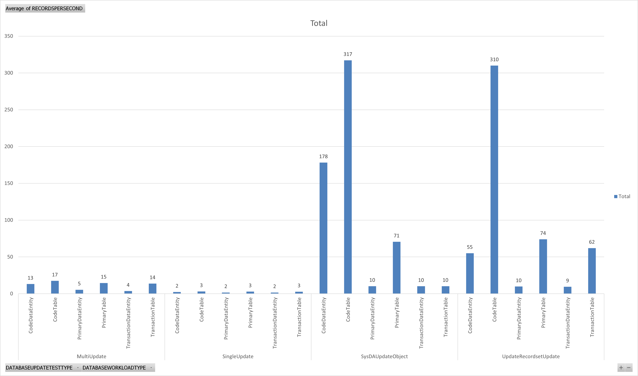
Best
Better
Good
Worst

Slide 24
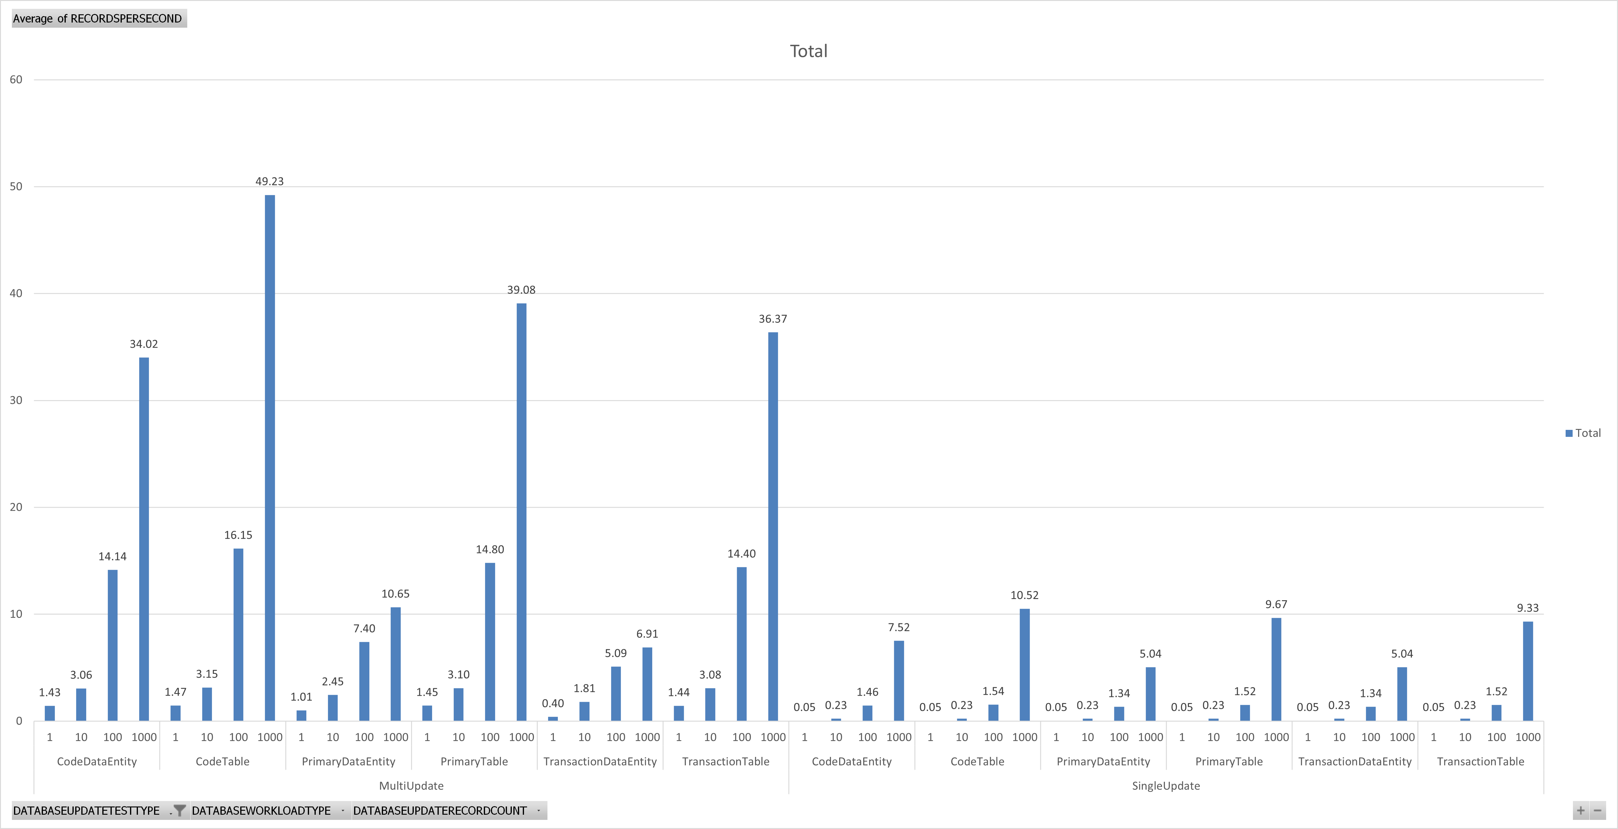
Good
Worst

Slide 25
Does specifying columns matter? (and also FirstOnly)
Yes
select firstonly AccountNum from CustTable;
select firstonly PaymTermId, LineDisc, PartyCountry, AccountNum, AccountStatement, BankAccount, Blocked, CashDisc, CashDisc, ClearingPeriod from CustTable;
select firstonly * from CustTable;

Slide 26
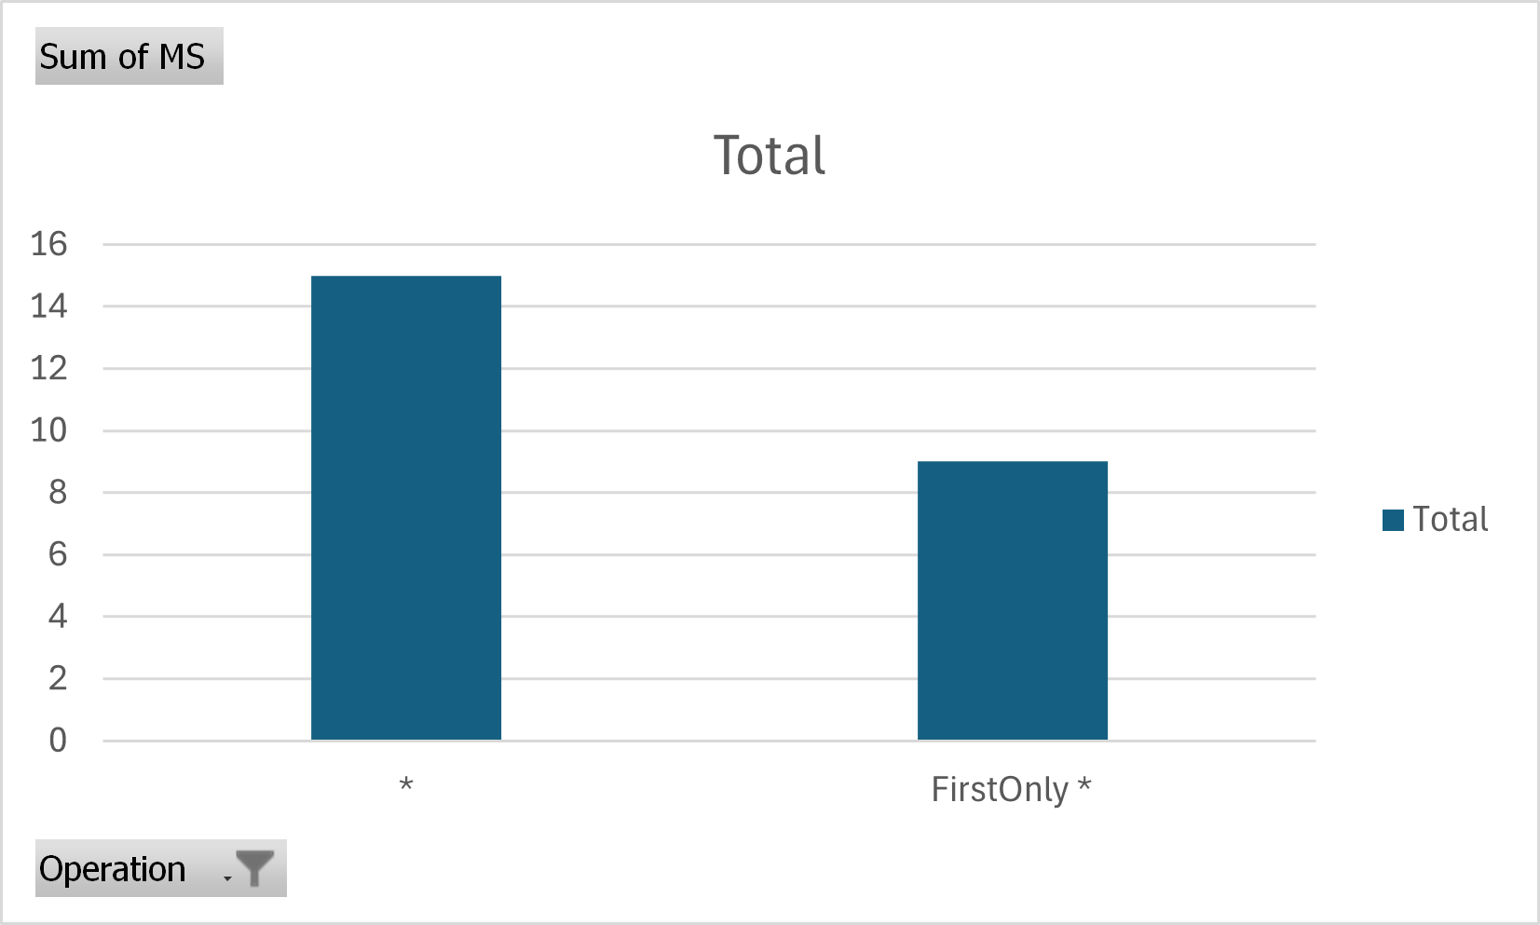
Does FirstOnly Matter?

Slide 27
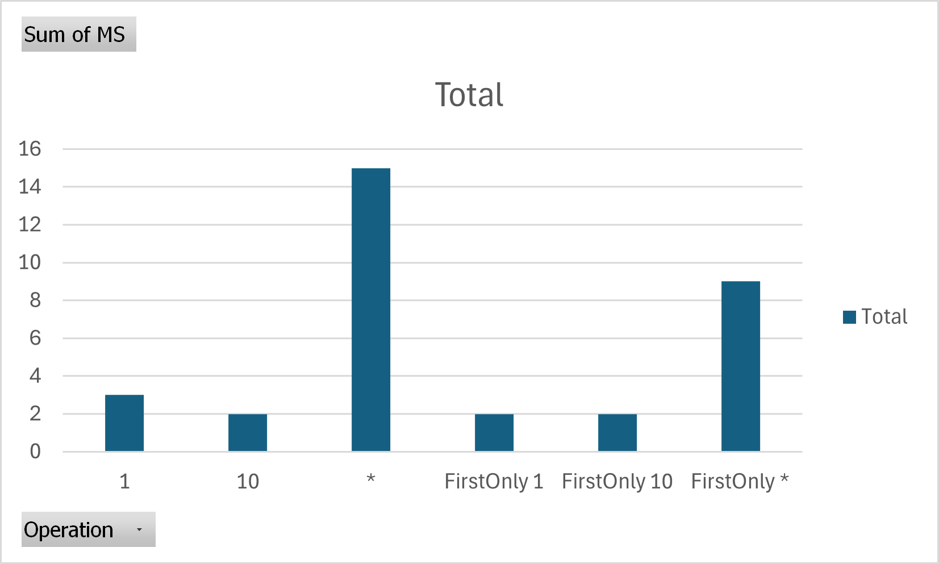
What about column specification?

Slide 28
Data Entity Performance
Are complex data entities slower?
Can you improve performance by removing data sources?

Slide 29
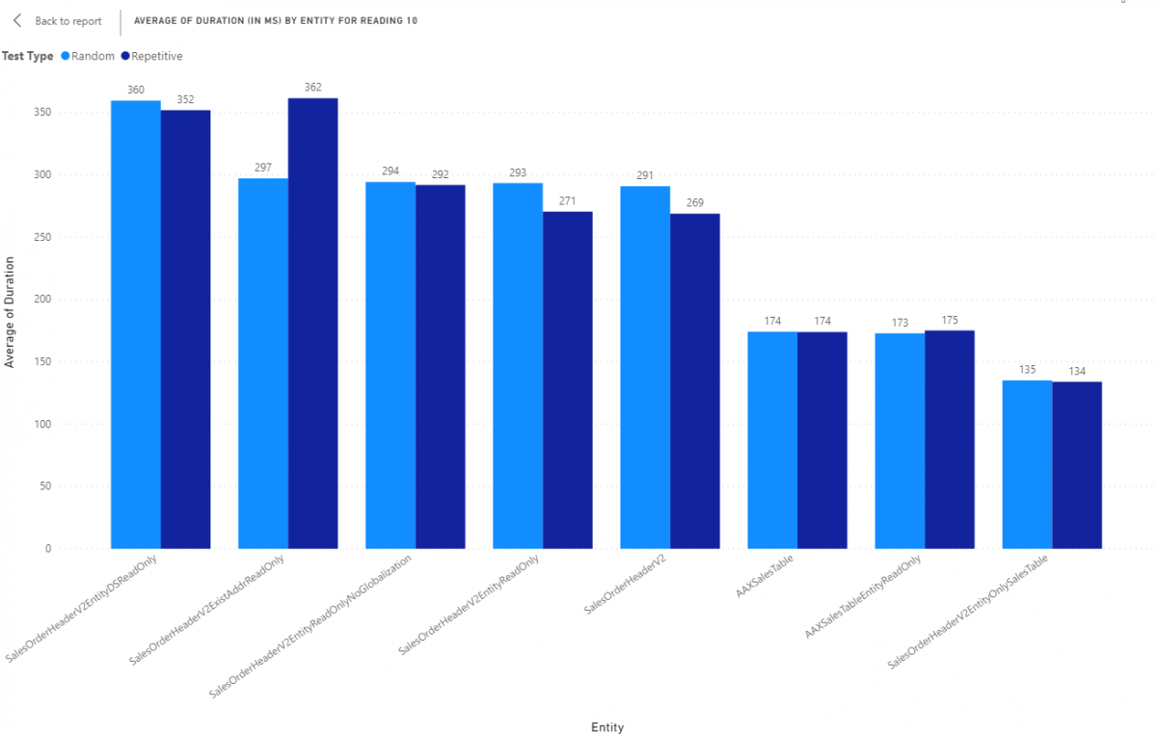
Data Entities

Slide 31

ForceSelectOrder and ForceNestedLoop
select generateonly firstonly forceselectorder forcenestedloop * from salesTable
join salesLine
where salesTable.SalesId == salesLine.SalesId;

Slide 32
ForceSelectOrder and ForceNestedLoop
SELECT TOP 1 [fields]
FROM salestable T1
CROSS JOIN salesline T2
WHERE ( ( T1.partition = 5637144576 )
AND ( T1.dataareaid = N'usmf' ) )
AND ( ( ( T2.partition = 5637144576 )
AND ( T2.dataareaid = N'usmf' ) )
AND ( T1.salesid = T2.salesid ) )
OPTION(loop JOIN, force ORDER)

Slide 33
Query Optimization - Bad
while select * from custTable
{
while select * from custTrans
where custTrans.AccountNum == custTable.AccountNum
{
info(strFmt("Transaction: %1 on %2", custTrans.InvoiceId, custTrans.TransDate));
}
}

Slide 34
Query Optimization - Good
while select AccountNum, Name, custTrans.InvoiceId, custTrans.TransDate
from custTable
join custTrans
where custTrans.AccountNum == custTable.AccountNum
{
info(strFmt("Customer: %1, %2 - Transaction: %3 on %4",
custTable.AccountNum, custTable.Name, custTrans.InvoiceId, custTrans.TransDate));
}

Slide 35
Query Optimization - Good
qbdsCustTable = query.addDataSource(tableNum(CustTable));
qbdsCustTable.addRange(fieldNum(CustTable, AccountNum)).value(queryValue("1000"));
qbdsCustTrans = qbdsCustTable.addDataSource(tableNum(CustTrans));
qbdsCustTrans.relations(true);
qbdsCustTrans.joinMode(JoinMode::InnerJoin);
qbdsCustTrans.addRange(fieldNum(CustTrans, TransDate)).value(queryValue(systemDateGet() - 30));

Slide 36
Database General Advice
Ask the database for data as needed but ask for everything you may need upfront
Opening/Closing transactions is the slowest part of any operation (typically)
Only ask for what is needed
Use Set Operations even if “downgrades” will happen
Downgrade means convert from set to row based operation
If a table has a insert(), update(), or delete() on it, this will result in a downgrade

Slide 37
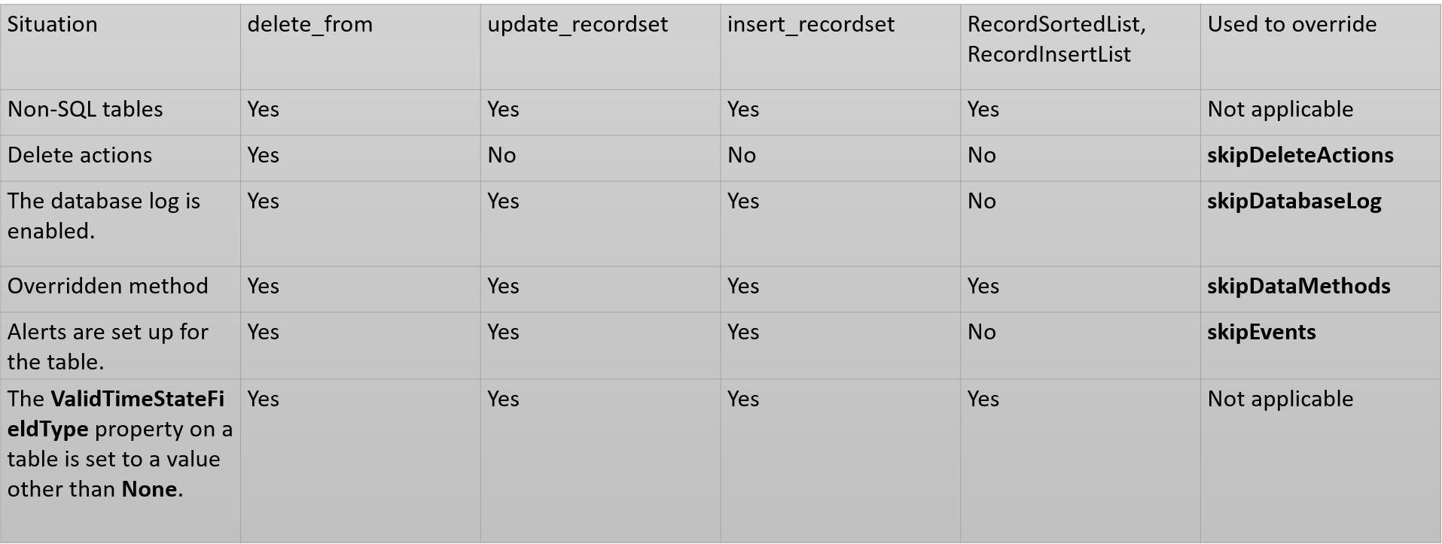
“downgrades”

Slide 38
Troubleshooting
Task Recording
Include Word Doc, Developer recording, and .axtr
Include the legal entity/company, date and time of day with time zone
Use Teams to record your screen if you can ( have a meeting with yourself )

Slide 39
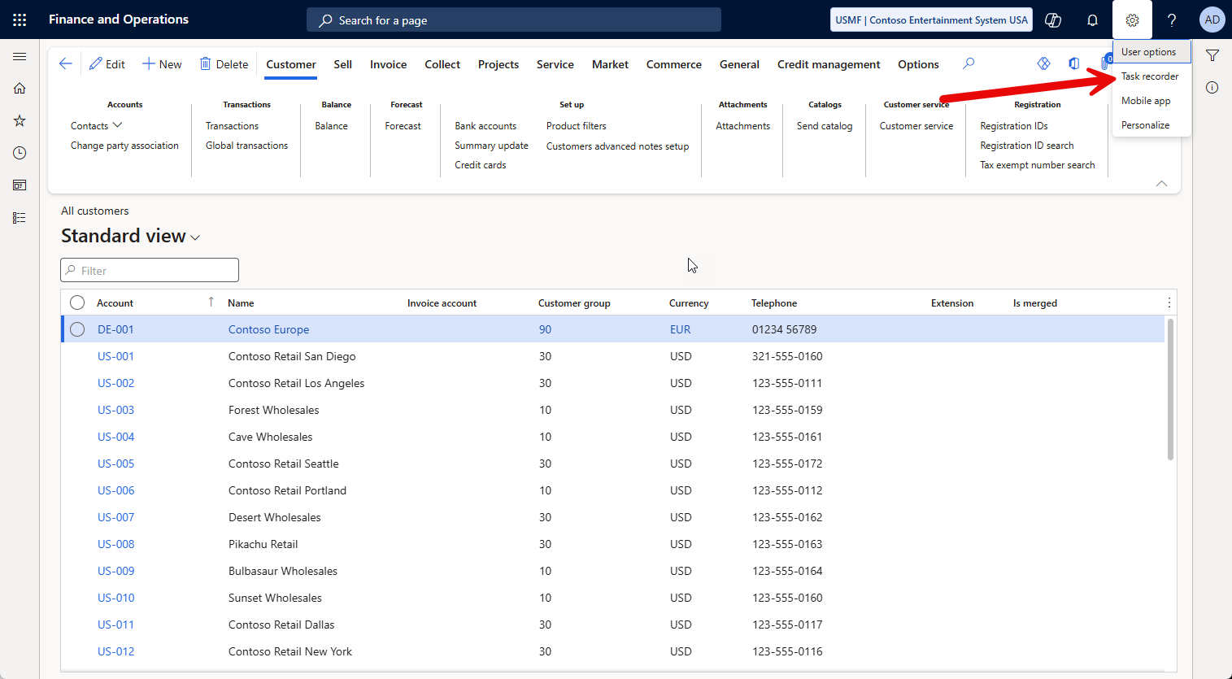

Slide 40
Trace Parser
What is a trace?
Detailed log of events, system calls, SQL queries, and resource usage captured while a specific task is being executed
Help > Trace

Slide 41
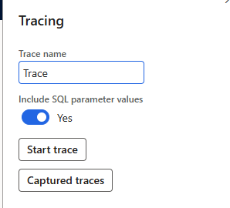
Trace Parser
SQL Parameters
Gives more insight, “costs” a little more when on
Only admins can see previous traces
Users need “System Tracing user” to capture a trace

Slide 42
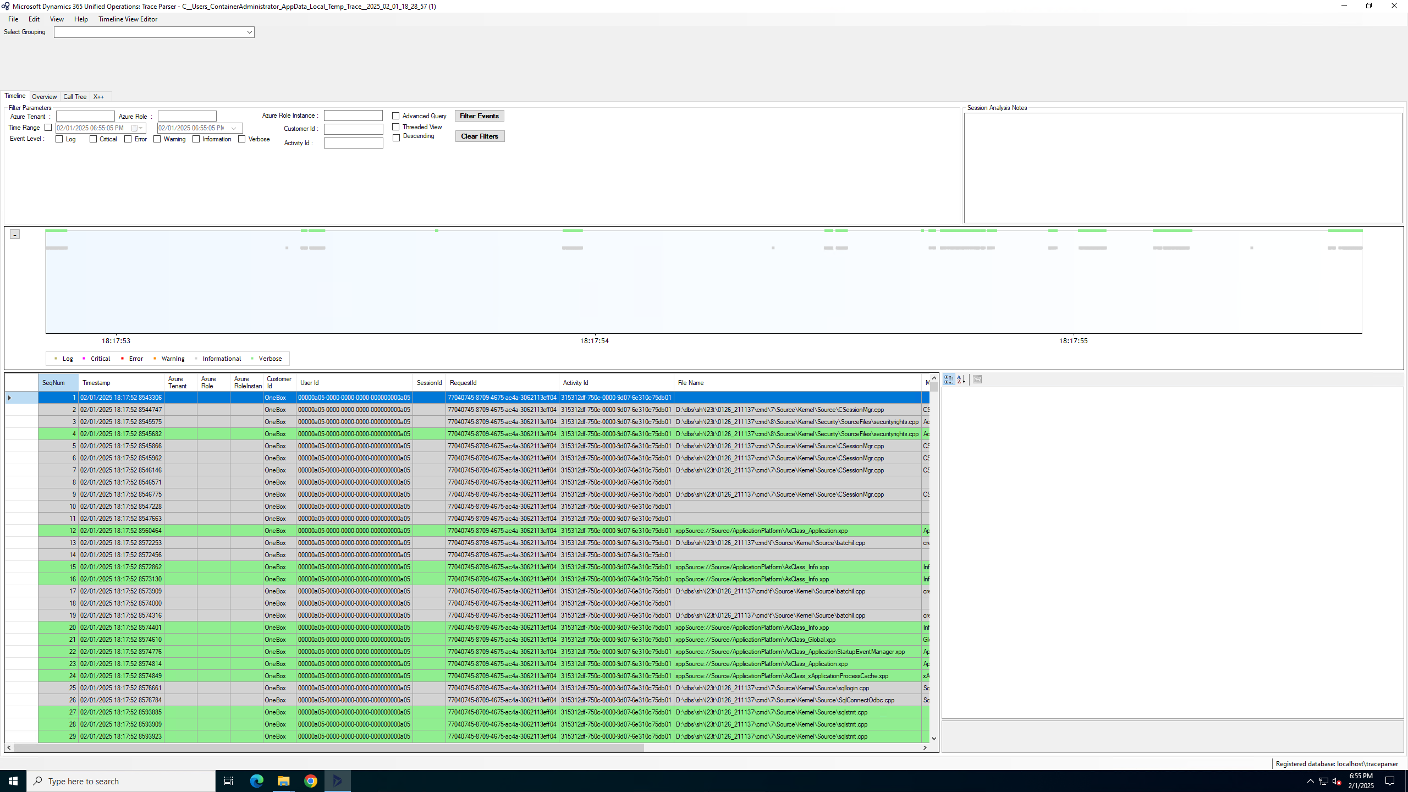

Slide 43
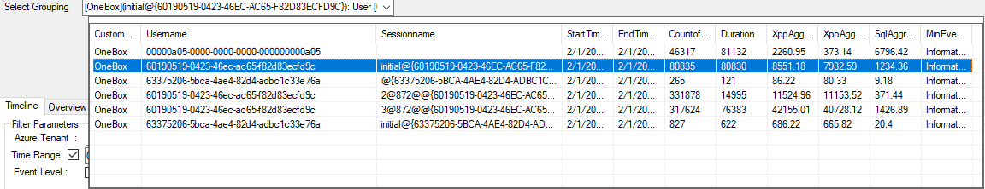

Slide 44
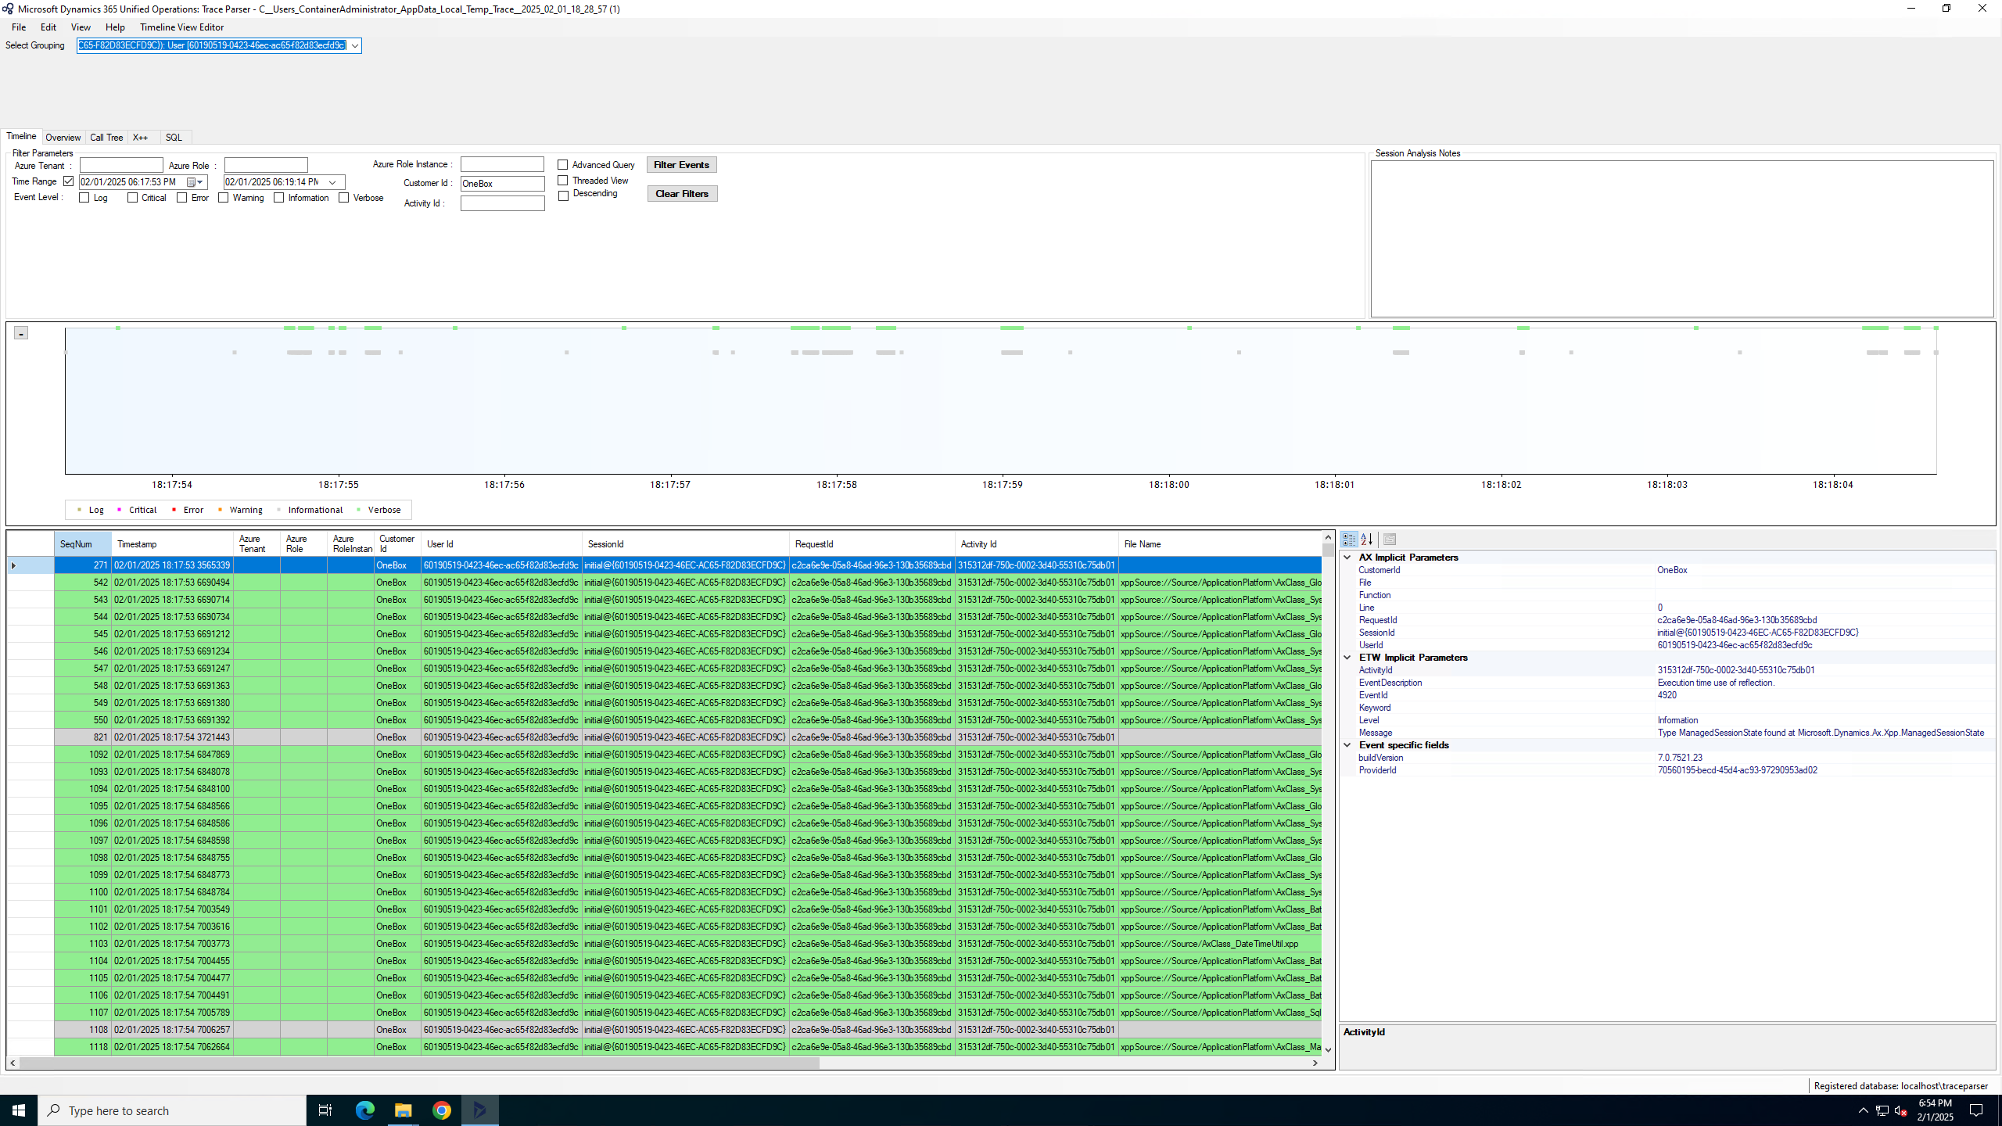

Slide 45
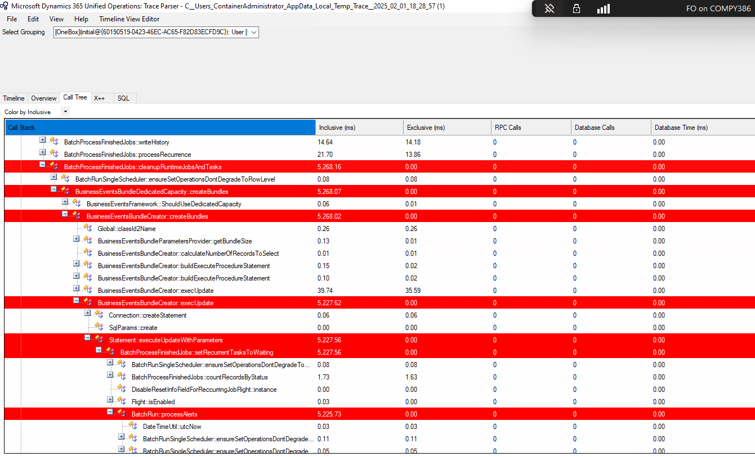

Slide 46
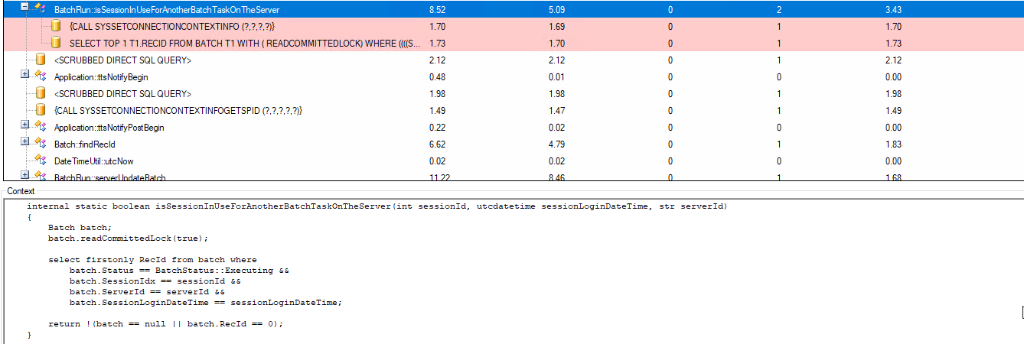

Slide 47
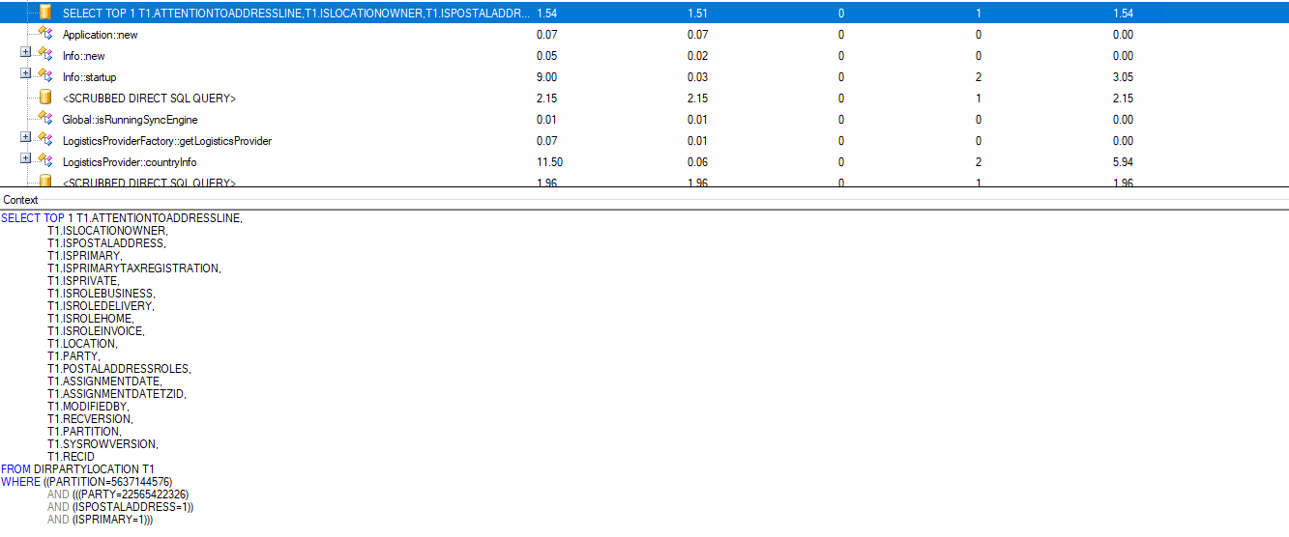

Slide 48

Socratex and XQuery
Can query against code (oversimplified)
Can be used to identify nested loops or other performance related patterns
XQuery can query your code like

Slide 49
Batch Jobs
Microsoft is released new versions of batch jobs
If something is slow, a new feature may be available

Slide 50
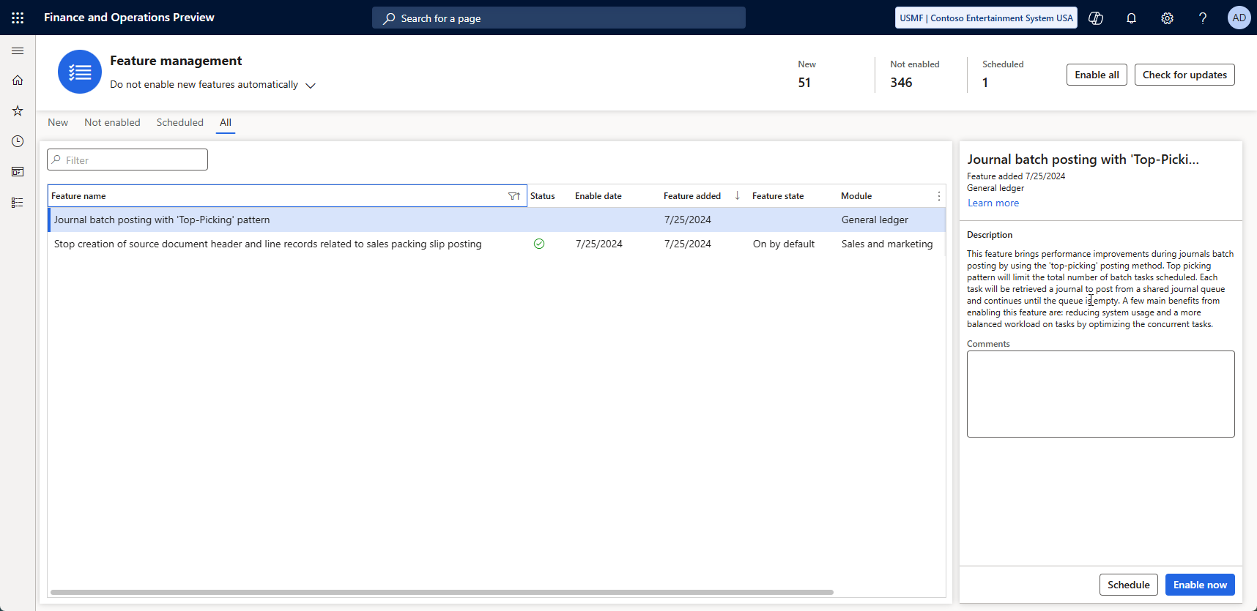

Slide 51

Custom Batch Jobs
“Classic” Batch Job
Individual Task Model
Batch-Bundle
Top-Picking
Each type has pros and cons

Slide 52
Custom Batch Jobs
Classic batch job
Slow but cheap
Single Threaded
Tried-and-True method that works
Individual Task Model
Fast but expensive
“all threaded”
Schedule everything and let batch sort it out

Slide 53
Custom Batch Jobs
Batch-Bundle
Moderate to Fast with some cost
Groups of tasks
Groups get completed 1 group at a time with multiple groups running at a time
Top-Picking
Fast with some temporal cost
“x threaded”
Setup x number of threads / lanes to execute all the work

Slide 54
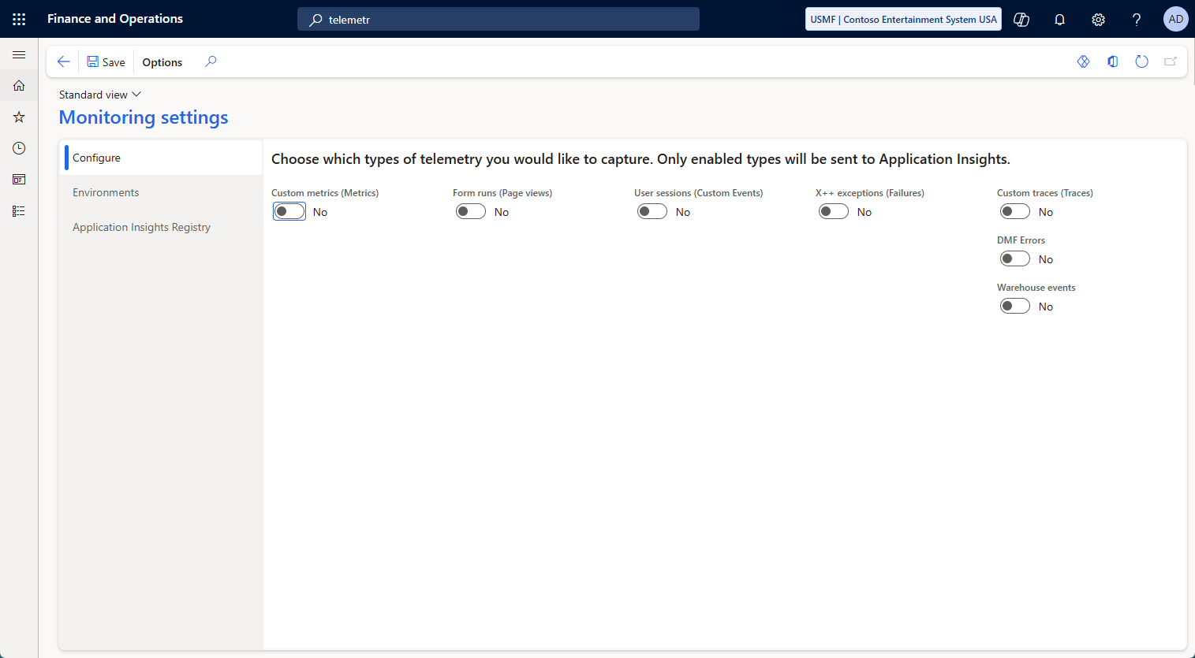
Telemetry
Turn on telemetry
Custom Metrics
Form runs ( Page Views)
User Sessions
X++ exceptions
Custom Traces
DMF Errors
Warehouse events
Add your own

Slide 55
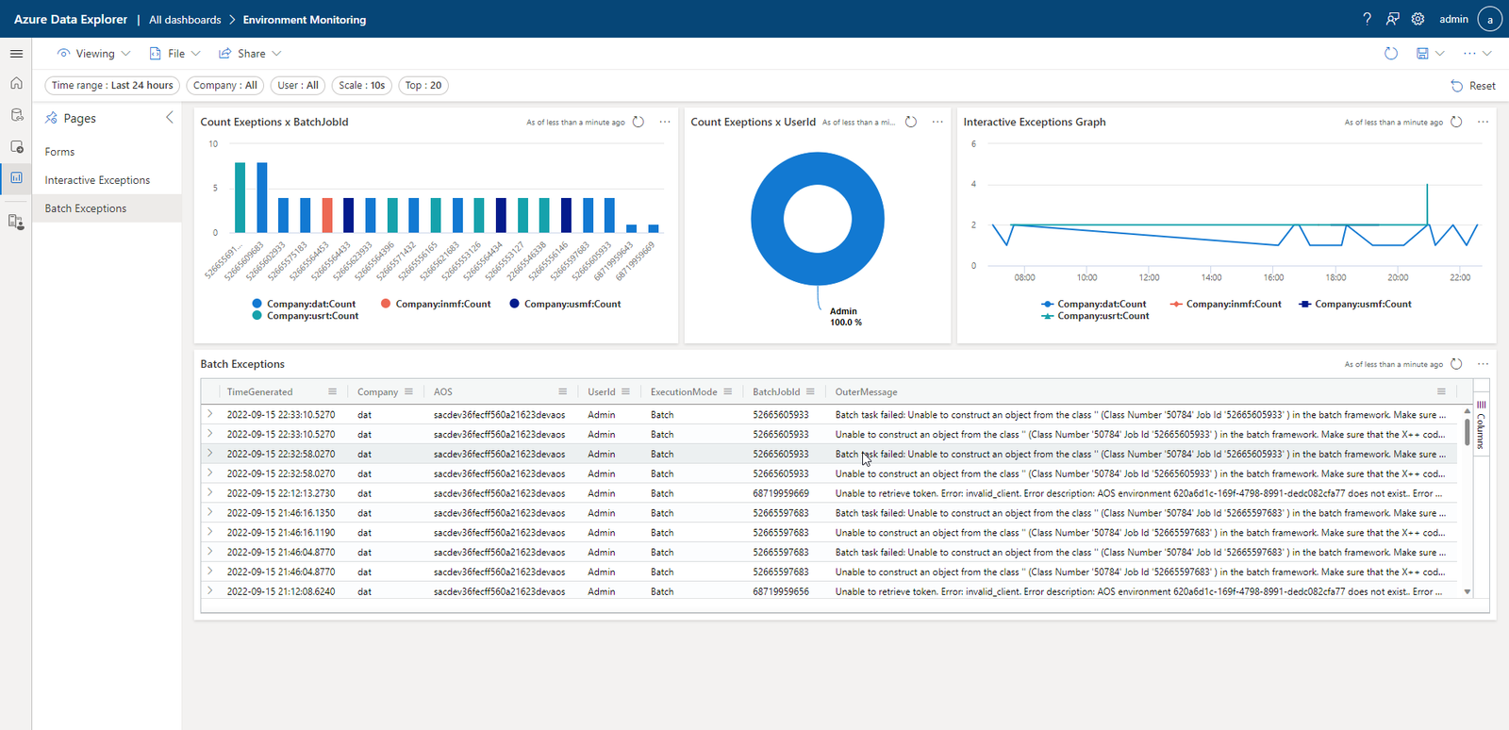
Notes:
Credit: https://samuelardilacarreno.com/2022/09/17/monitoring-and-telemetry-for-dynamics-365-finance-and-operations/

Slide 56

LCS
Limited insight
Reducing functionality over time
No automation available for most logging functionality
Slow

Slide 57
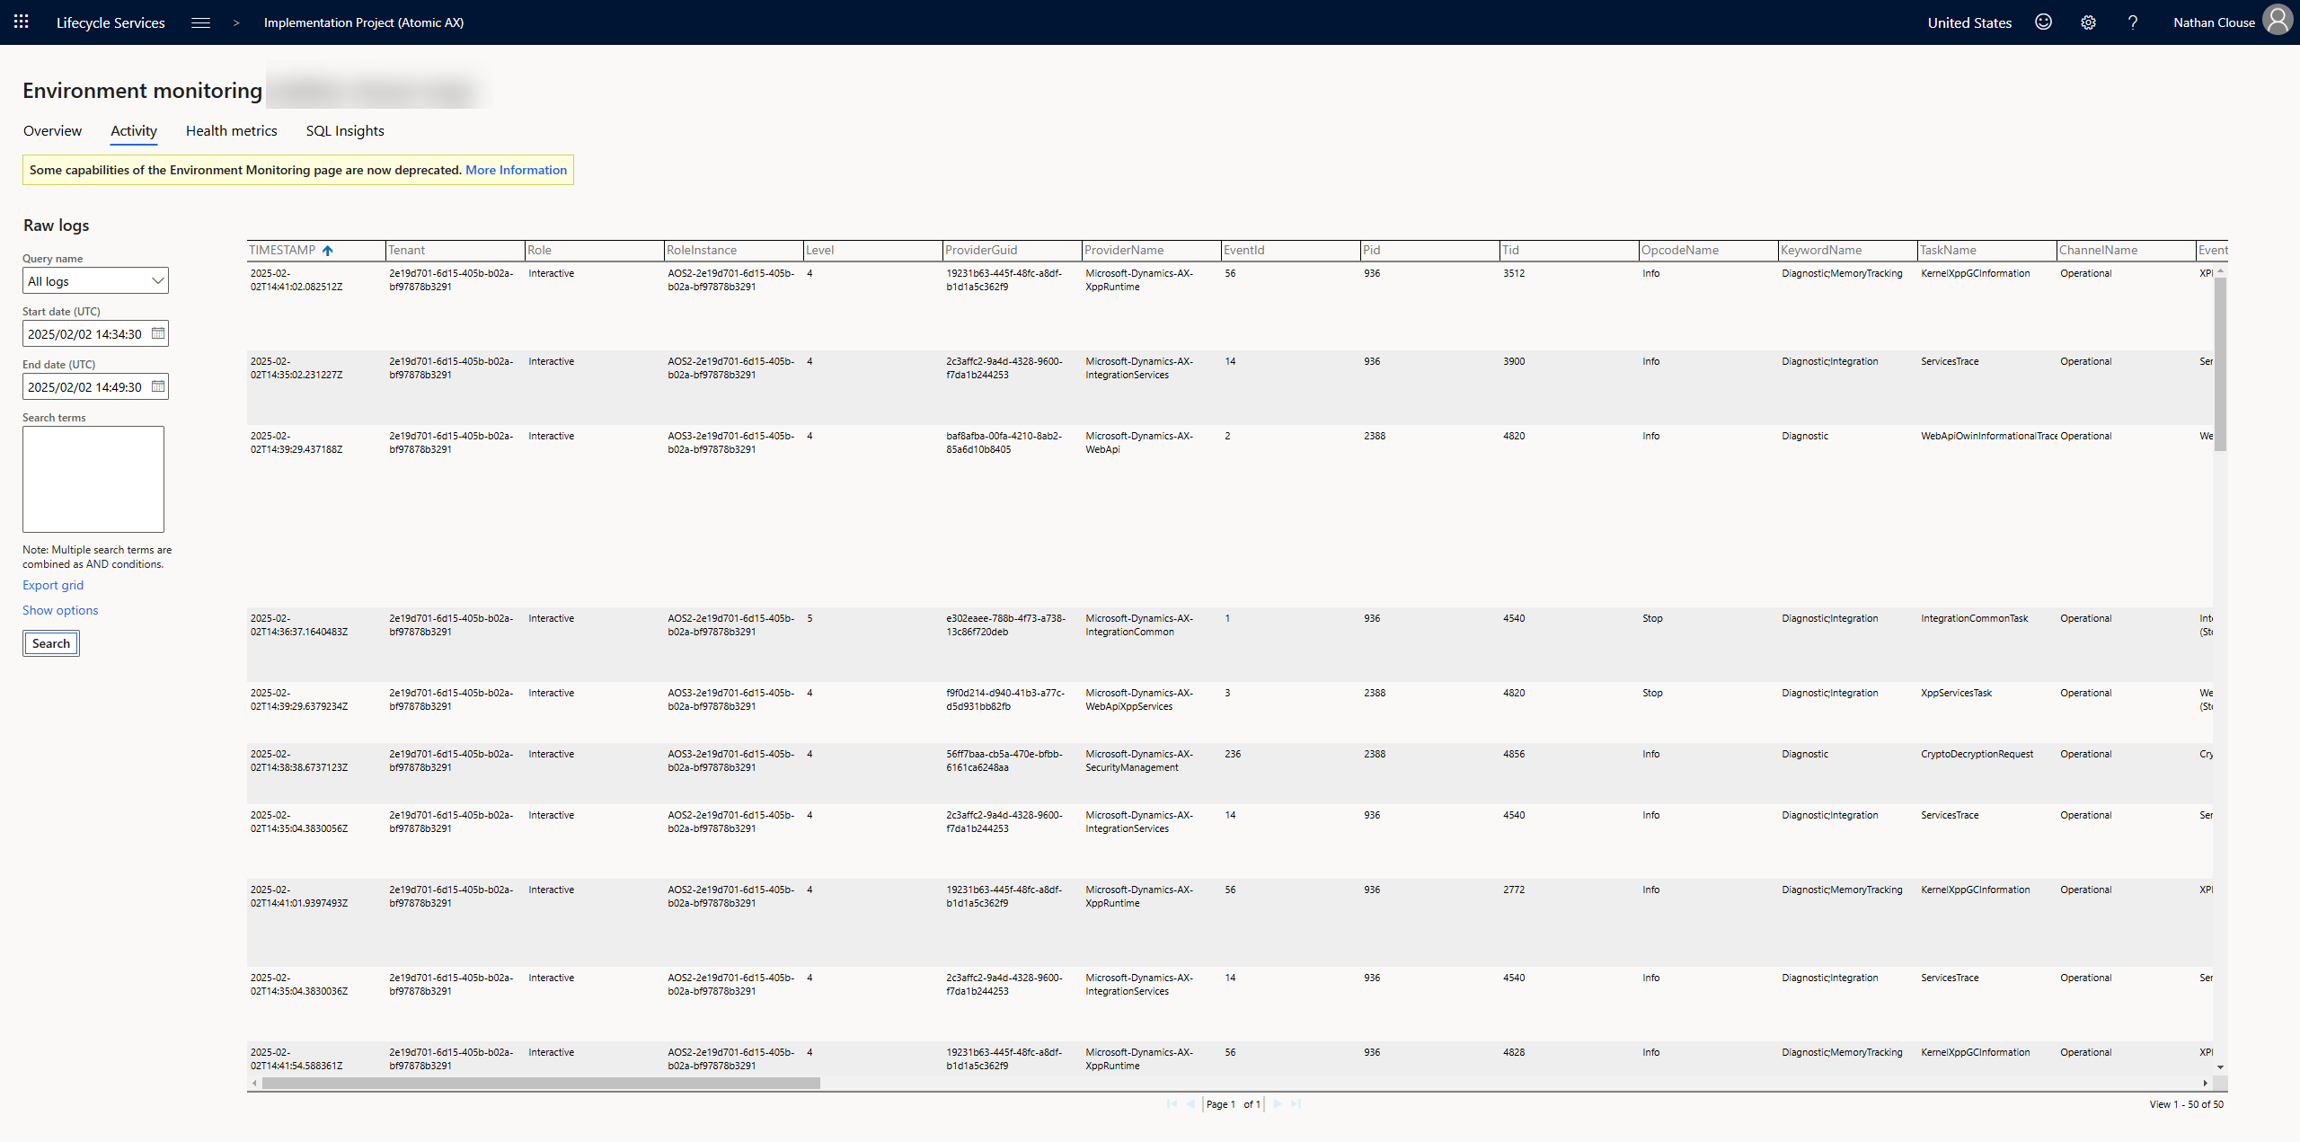

Slide 58
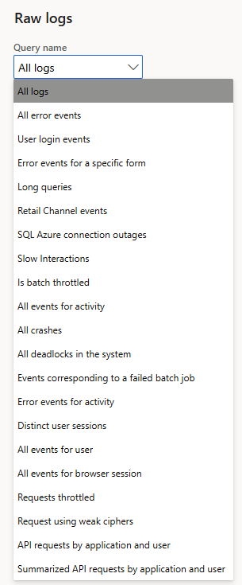

Slide 59

Tweaks
Use Cleanup Batch jobs
Go to module > expand all > search for “Cleanup” or “clean”
Also check out Process Automation
Similar to Batch Jobs
Auto register and schedule based on code rules

Slide 60
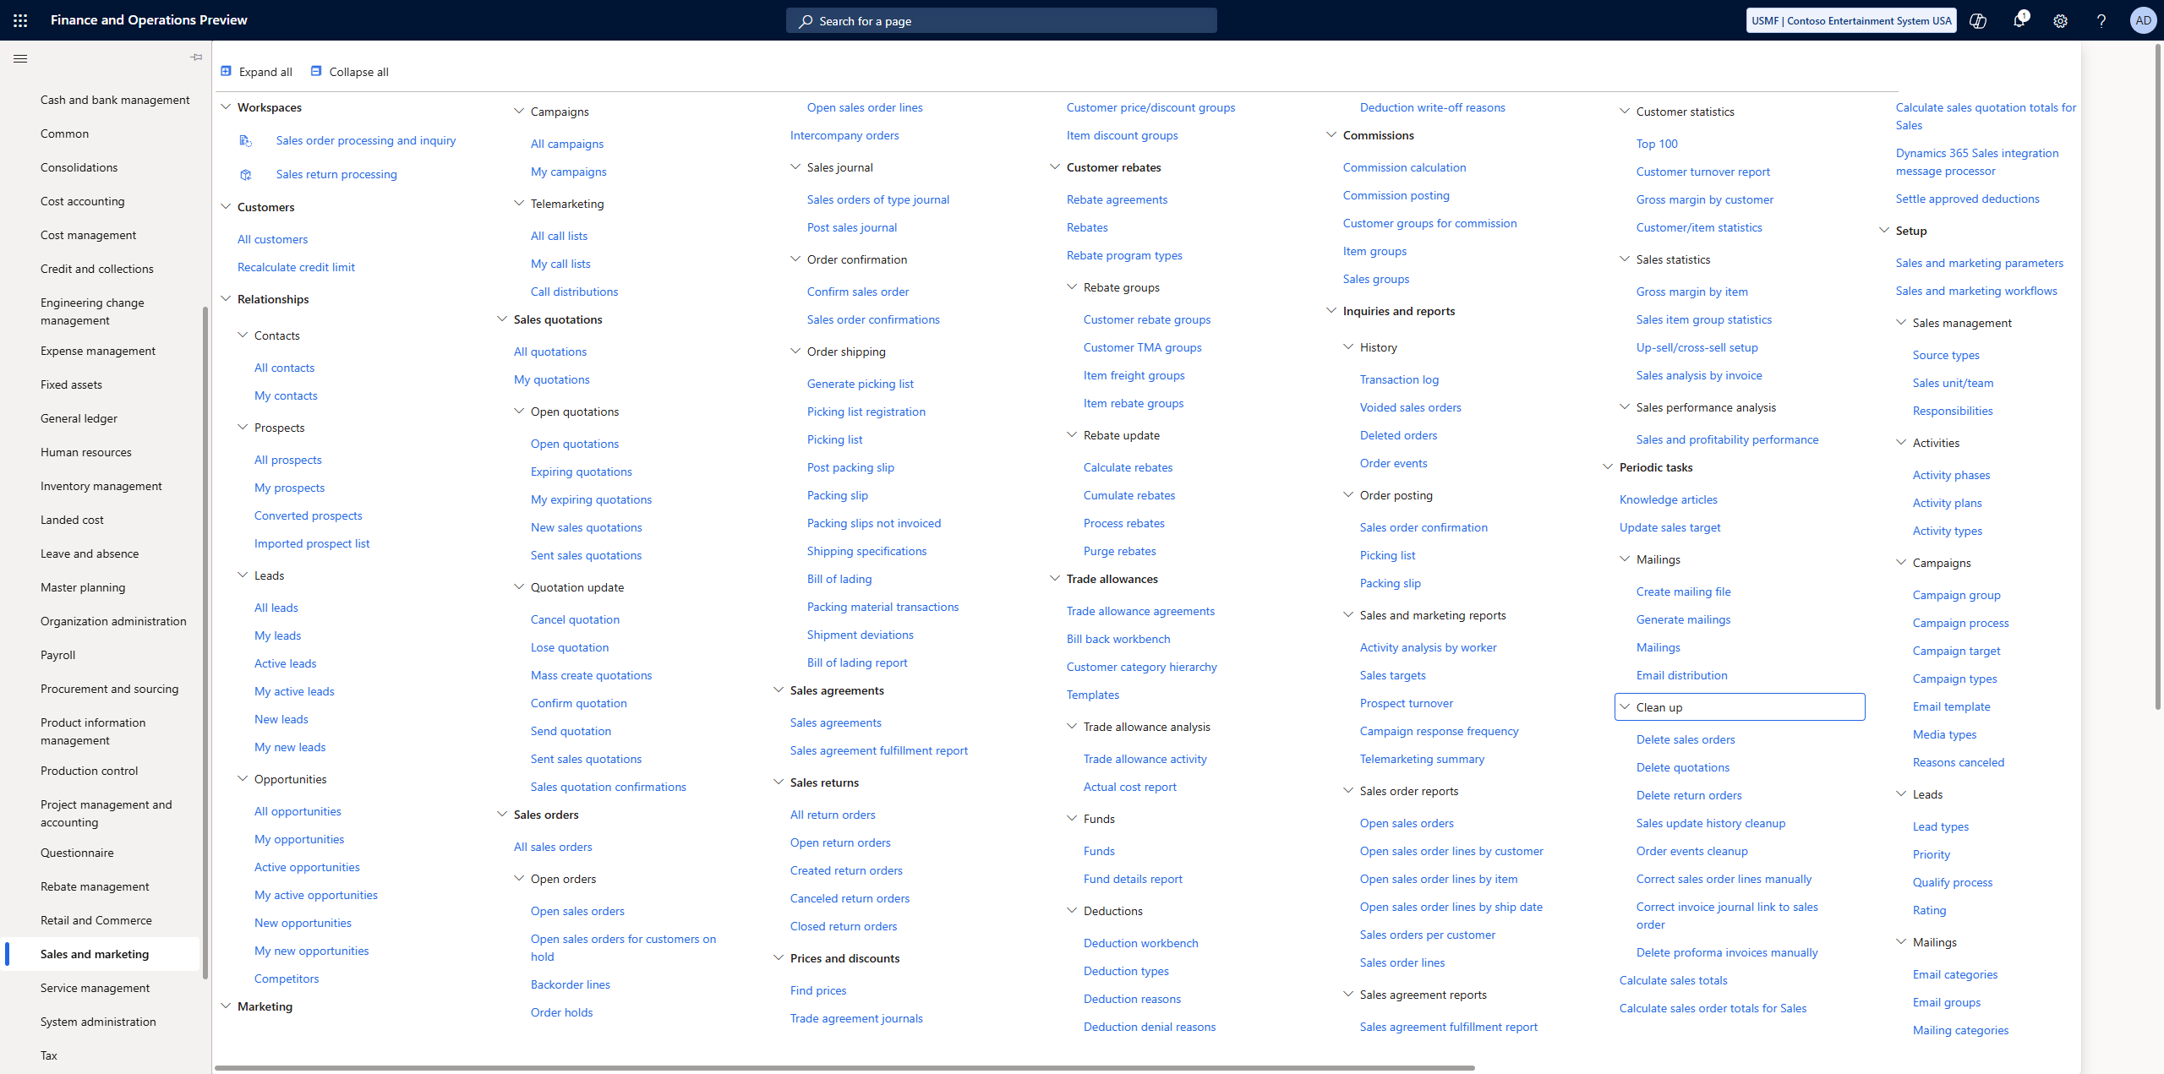

Slide 62
Summary
Use Set operations rather than row operators when you can
Understand the constructs used for data manipulations
Use Trace Parser to get detailed log data on performance issues
Identify database or code ( or both ) issues using tools like LCS and Trace Parser
Use Telemetry to monitor

Slide 63
References
https://community.dynamics.com/blogs/post/?postid=77bd7a1b-5cc7-4947-a724-109d41d113b3
https://community.dynamics.com/blogs/post/?postid=fc6c120d-b134-47ef-9651-b4deb7d3560c
https://ariste.info/2021/06/socratex-application-checker/
https://community.dynamics.com/blogs/post/?postid=b8014884-9aa3-4fdb-8e2a-b3440d01a79a
https://alexdmeyer.com/2023/10/03/using-telemetry-data-for-read-auditing-in-d365fo/
https://github.com/microsoft/Dynamics-365-FastTrack-FSCM-Telemetry-Samples

Slide 64
References
https://www.atomicax.com/article/does-specifying-columns-select-statements-matter
https://www.atomicax.com/article/database-inserts-and-performance
https://www.atomicax.com/content/odata-experiment-deep-dive-odata-and-how-use-it
https://www.atomicax.com/article/when-create-runbasebatch-batch-job
https://www.atomicax.com/article/when-create-individual-task-modelled-batch-job

Slide 65

Questions?

